Slide 1
Active Learning
Let’s DO This!

Slide 2
Active Learning: But Why?
We need to create structures designed for equality
Active learning increases retention, understanding, and applicability well beyond the test
It gives students agency over their own learning
Encourages discovery & the “productive flail”
“An ‘Active Learning’ Kit: Rationale, Methods, Models, Research, Bibliography” - Cathy Davidson
“If Students Aren't Flailing, We're Failing…” - John Warner

Slide 3

Active Learning: But How?
Students are involved in more than listening
Less emphasis is placed on transmitting information and more on developing students’ skills.
Students are involved in higher-order thinking (analysis, synthesis, evaluation)
Students are engaged in activities (e.g. reading, discussing, writing)
Greater emphasis is placed on students’ exploration of their own attitudes and values
Anything that involves students in doing things and thinking about the things they are doing.
Charles Bonwell and James Eison

Slide 4
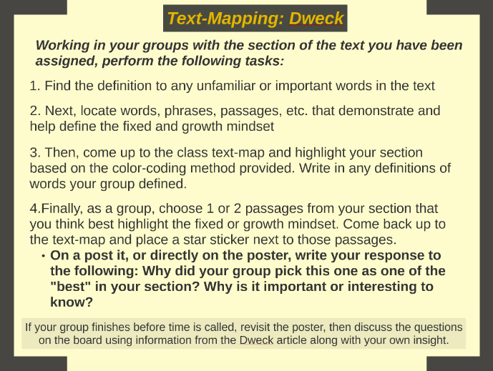
But How?

Slide 5
Questions, Concerns, Ideas?
How do we deal with the “tyranny of the clock”?
How can and do each of us model and honor ways of creating “authority” in the room without replicating “authoritarian” examples?

